Slide 1
ECE 157B Section
Homework 4.1
Text Processing
Part 1: LSTM
University of CA, Santa Barbara

Slide 2
HW Goal
X: stackoverflow questions
How do I make an OrderedDict?
Y (classification): what language? Java, C#, JS, Python?
Python

Slide 3
Overview
Preprocessing Text for Keras
Load and preprocess text data
Train a tokenizer (vectorizer)
RNN (LSTM) Networks
Architecture review
Pros/cons

Slide 4
RNN Review
RNN is ?
They always draw them like this. What does that mean?
Let’s unroll …
Y
RNN
X

Slide 5
RNN Review ¹
RNN is made up of many cells.
They process the input 1 vector at a time.
X1
X2
X3
Xn

Slide 6
RNN Review ¹
The “recurrent” aspect
Each cell uses the previous cell output (state) to construct the new state.

Slide 7
RNN Review ¹
The “recurrent” aspect
Each cell uses the previous cell output (state) to construct the new state.

Slide 8
RNN Review ¹
The main issue: memory!
Sometimes, people (@Dickens) like to write long sentences.
“It was the best of times, it was the worst of times, it was the age of wisdom, it was the age of foolishness, it was the epoch of belief, it was the epoch of incredulity, it was the season of light, it was the season of darkness, it was the spring of hope, it was the winter of despair.”
It
was
the
best
of
times
,
it
…
60 tokens!
…
…
winter
of
despair

Slide 9
RNN Review ¹
The main issue: memory!
Sometimes, people (@Dickens) like to write long sentences.
“It was the best of times, it was the worst of times, it was the age of wisdom, it was the age of foolishness, it was the epoch of belief, it was the epoch of incredulity, it was the season of light, it was the season of darkness, it was the spring of hope, it was the winter of despair.”
Remember, each cell ALWAYS sends its state to the next.
By the time you get to the last word “despair”, our state is supposed to include SIXTY words worth of information.
With activation Tanh, this means the first word “it” will at best make up 2% of the state (and thus, a small gradient).
Without activation, our state might explode (and thus, a massive gradient).

Slide 10
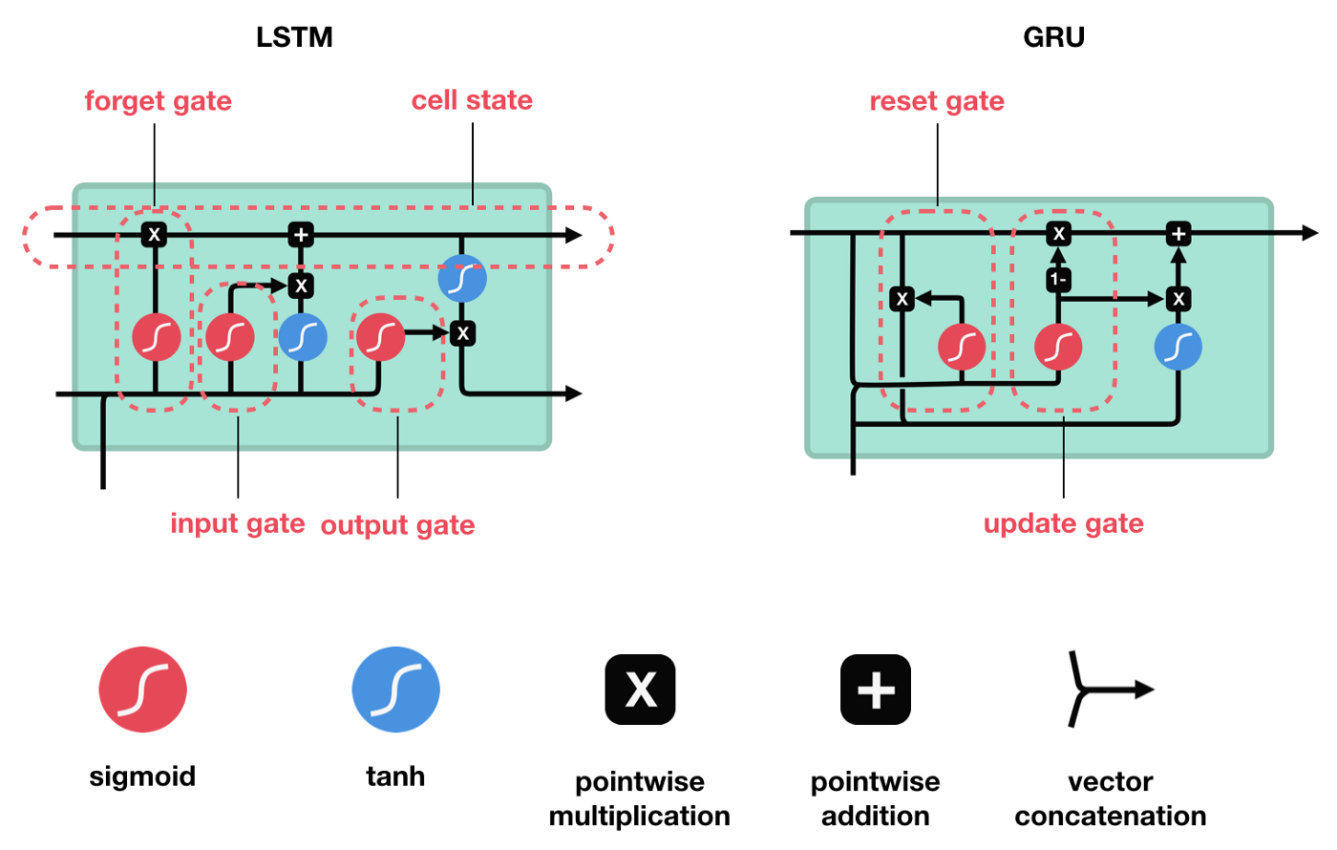
LSTM Review ¹
Solution: add “gates” that control when we:
Forget the state
Use the input
Output
Also, adds a “cell state” on
top of the “hidden state”.

Slide 11
Forget Gate ¹
Purpose as english: “Do we keep (parts of) the hidden state?”
Decides based on previous hidden state and new input

Slide 12
Input Gate ¹
Purpose as english: “Which part of the input should I use to update?”
Decides based on previous hidden state and new input

Slide 13
Update ¹
Now, do a normal RNN Update but using (state after forgetting) and (input that I decided was important)

Slide 14
Output gate ¹
Purpose as english: “From my updated state, what should I use as output?”
Decides based on previous hidden state and new input

Slide 15
LSTM Review ¹
Otherwise, the structure is the same!
The forget gates let us keep information as long as we need, then we can get rid of it.
The input gates let us decide to use an input now or use it later
The output gates let us decide when to (finally) use the information we’ve gathered.

Slide 16
Review Reference
Illustrated Guide to LSTM’s and GRU’s: A step by step explanation | by Michael Phi | Towards Data Science

Slide 17
Code: Tensorflow Datasets
# Load a dataset
data_raw = preprocessing.text_dataset_from_directory(
data_dir,
**dataset_args
)
# Look at 1 value in BATCHED?
# Actually have to go through batches first
for batch_x, batch_y in data_raw:
print(batch_x[0], batch_y[0])
break
# Look at 1 value in BATCHED? Equivalent
# Actually have to go through batches first
for batch_x, batch_y in data_raw.take(1):
print(batch_x[0], batch_y[0])
# Look at 1 value in NON-BATCHED?
# Here, we wouldn’t need to look through a batch index first
for x, y in data_raw.take(1):
print(x, y)
The tutorial is pretty clear on loading the datasets initially, but it’s hard to use after that.
You can’t always index normally. It might be organized in batches.
You can iterate through batches.
You can get some batches/values by using “take”

Slide 18
Code: Maps
x = [1, 2, 3, 4]
def dbl(x):
return 2*x
y = map(dlb, x)
print(y)
print(list(y))
>> map object
>> [2, 4, 6, 8]
map takes a function and an iterable
general python maps are “lazy”. They don’t evaluate until you ask them to.

Slide 19
Code: Maps with Tensorflow Dataset
# Load a dataset
data_raw = preprocessing.text_dataset_from_directory(
data_dir,
**dataset_args
)
# Load a version that is text only by passing function to be
# a lambda function on a tuple (q,l) that only returns the
# first value q
remove_label = lambda question, label : question
text_only = data_raw.map(remove_label)
# Use that text only version to make a dataset with the
# vectorized values
vectorize = # follow the tutorial(s) to find this line
encoded_text = text_only.map(vectorize)
Using the “map” in tensorflow datasets similar. It changes each entry.

Slide 20
Code: Embedding layer
You’ll have code to make a “vectorizer” that converts words to integers. After that, there is an embedding layer!
layers.Embedding( input_dim = vocab_length,
output_dim = 32,
mask_zero = True,
input_length = 250,
name = 'embedding'
)
This changes each integer into a VECTOR of a length (here, 32).
Keep in mind this is confusing with the names.
3 word sentence
Vectorizer
3 integer “vector”
Embedding
3 x 32 matrix

Slide 21
Time for…
Questions?
(Before moving onto coding examples)

